Slide 1


Final Assignment
Design and implementation of logistics management system
Zifeng Xu 001045590
Yutong Zhen 001557715
Jiajia Liu 001568540

Slide 2
CONTENTS
01
Design Background And Ideas
02
Database Information
03
Demand Analysis
04
Diagram Information
05
Conclusion

Slide 3
01
Design Background And Ideas
Part

Slide 4


Design Background And Ideas
Background
Database to store all the business data of the company uniformly。
It can realize the unified storage and reading of data。
Achieve the logistics distribution of every link of resource sharing. In order to improve the efficiency of business processing
请替换文字内容
请替换文字内容，修改文字内容，也可以直接复制你的内容到此。请替换文字内容，修改文字内容，也可以直接复制你的内容到此。
Using the computer to manage the logistics enterprise information, to achieve information storage, transportation, vehicle scheduling management system, greatly improve the work efficiency, for the enterprise to create better benefits

Slide 5
02
Database Information
Part

Slide 6
Database Information
1.Realize data sharing : All users can access the data in the database at the same time,
including users can use the database in various ways through the interface, and provide
data sharing.
2.Reduced data redundancy: Because of the database sharing, it could avoid the use
to create the application file separately. Reduces a large number of duplicate data,
reduces data redundancy, and maintains the consistency of data.

Slide 7
03
Demand Analysis
Part

Slide 8
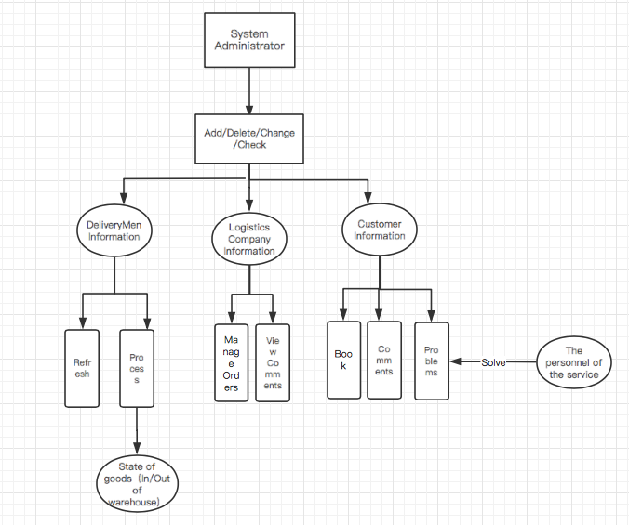
Demand Analysis
Users can register an account with their job number to log in to the system for business operations.
Mainly including Customer information management, DeliveryMan information management, Logistics Company information management.

Slide 9
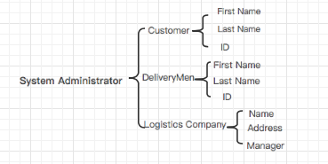
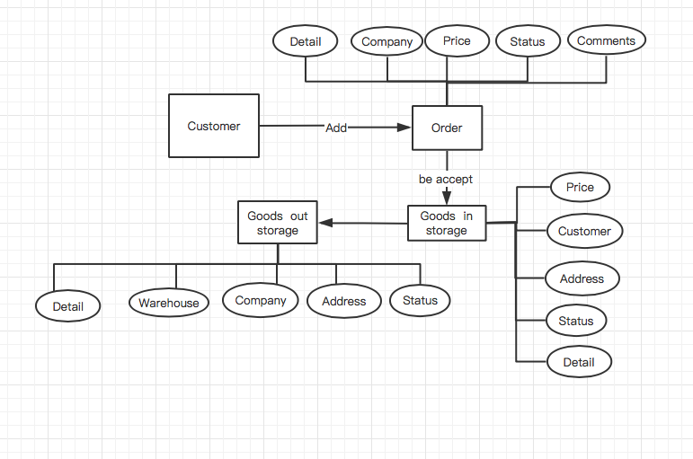
Model Instructions
Order management
Basic information management

Slide 10
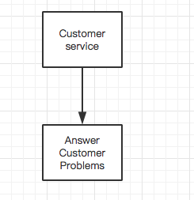
Model Instructions
Data Management
Answer Problems

Slide 11
04
Diagram Iinformation
Part

Slide 12
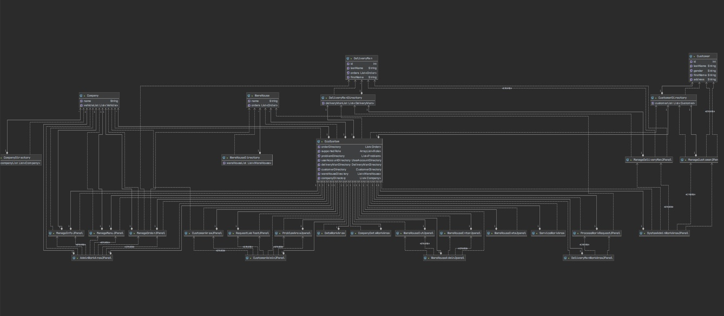
UML Diagram

Slide 13
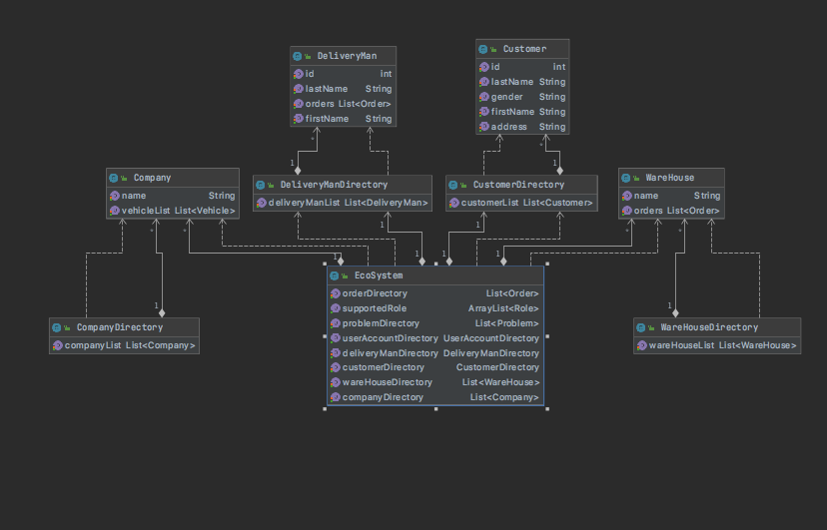
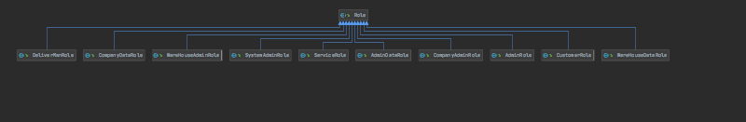
UML Diagram
System
点击请替换文字内容
请替换文字内容，添加相关标题，修改文字内容，也可以直接复制你的内容到此。
点击请替换文字内容
请替换文字内容，添加相关标题，修改文字内容，也可以直接复制你的内容到此。
Role

Slide 14
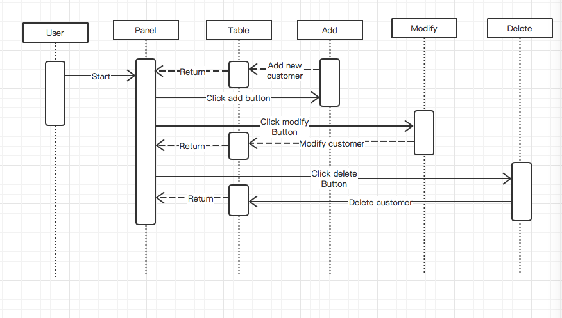
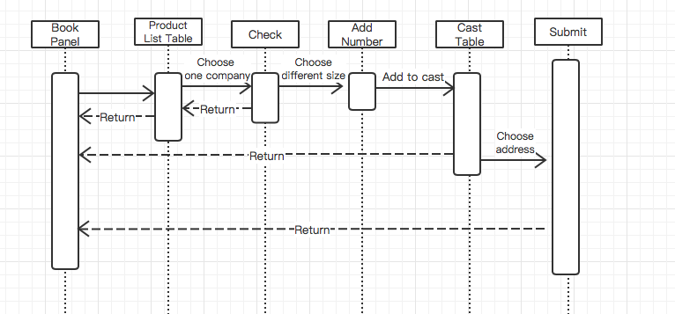
User Sequence Diagram
Customer Book Sequence
Customer Management Sequence

Slide 15
05
总结
章 节
Part

Slide 16
总结
仍存有的问题
解决方法
边缘地带仍存有贫困现象
三大产业分布不均，产业结构不够和谐
城镇体系不完善
推进精准扶贫
加快构建特色产业体系
着力打造新型城镇体系
……
……

Slide 17
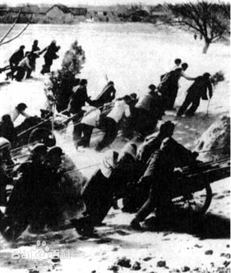
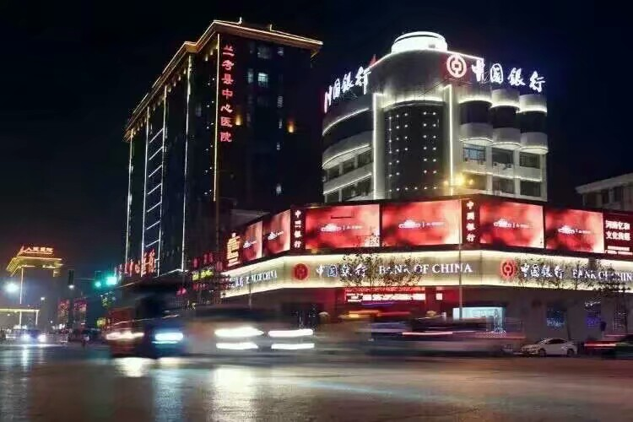
谢谢观看！

